Slide 1

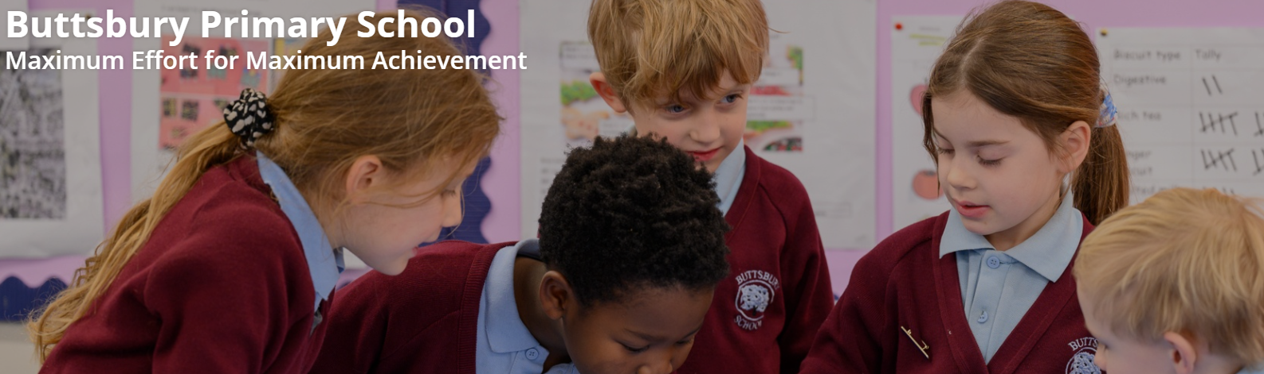

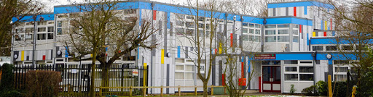

BUTTSBURY PRIMARY SCHOOL – JUNIOR SITE
We can’t wait to welcome your children and you to Year 3!

Slide 2
Your Year 3 Team
Miss L. Pretty/Mrs S. Barnes – Year Group Leader (3P) - Oak
Miss A. Watson (3W) – Acting Assistant Year Group Leader - Birch
Miss K. McCarty (3M) - Willow
Mrs M. Barker (3BW): Monday - Wednesday
Mrs H. Wilson (3BW): Thursday – Friday
- Elm
Notes:
UPDATE STAFF

Slide 3
National Curriculum
More information coverage at the Year 3 Curriculum Share evening on Monday 8th September 2025
Sets for Maths
  Baseline assessment – 2nd week back
  Fluid sets
  Maths sets will start at the start of Week 3!
Notes:
Will be in contact if there are any concerns or a child is going to move sets.
Don’t be disheartened if your child is the not in the set that they are in at the infants.
Curriculum share 3.30 and 4pm

Slide 4
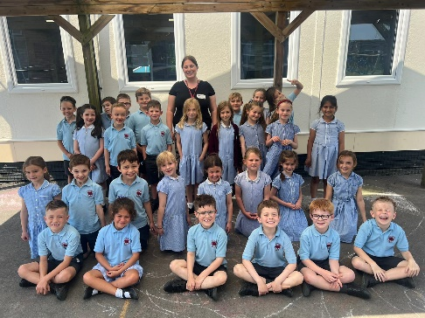
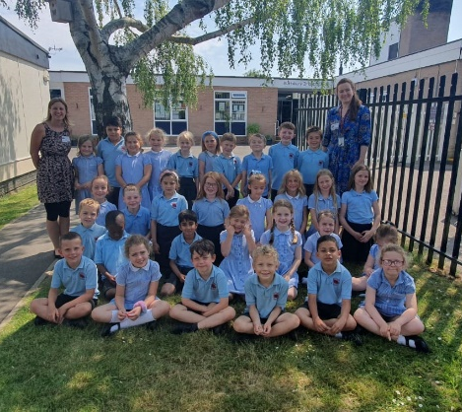
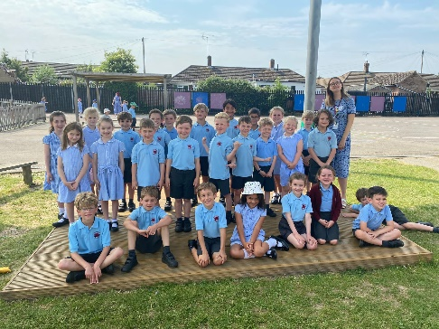
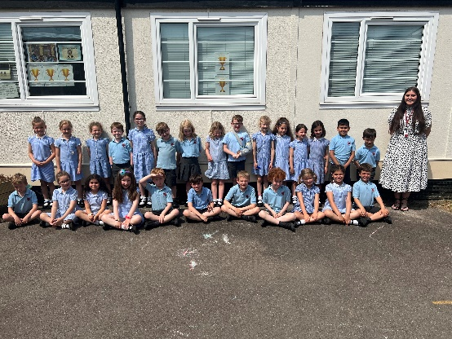
Year 2 to 3 Bridging
New Year 3 teachers will visit the infant school (9th and 10th June)
Children will come over to meet their teacher and have a tour around the school (Thursday 26th June)
Holiday activity will be set before the end of term.
Children write back to the Infants in Autumn.
Year 2 teachers spend a morning at the Juniors in the Autumn Term.
Notes:
POSSIBLY NEEDS CHANGING

Slide 5
Your Child’s First Day
Tuesday 2nd September 2025.
Please arrive for 9.00am – first day only.
Children to line up in their classes in the playground.
Teachers will be there to greet the children.
Parents please stand at the side or back of the playground.
For the first two weeks you will be able to pick your child up after school from the top playground.
Please ensure your child knows where to meet you at 3.20pm.
After the first day, the children will be allowed into their classroom between 8.30am and 8.40am. Parents please wait at the gates.

Slide 6
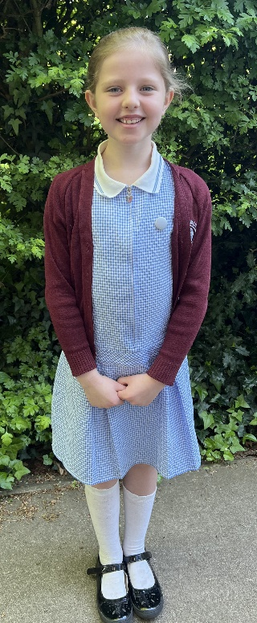
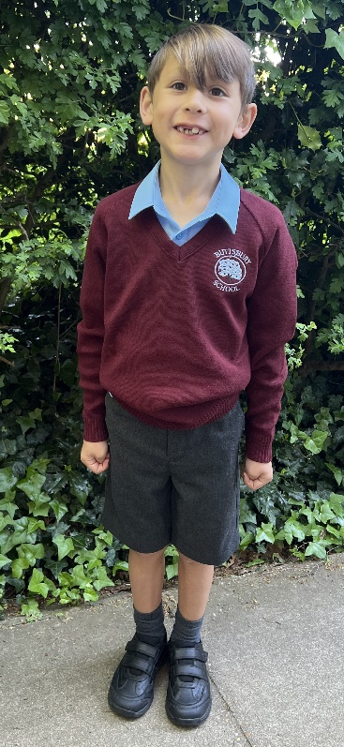
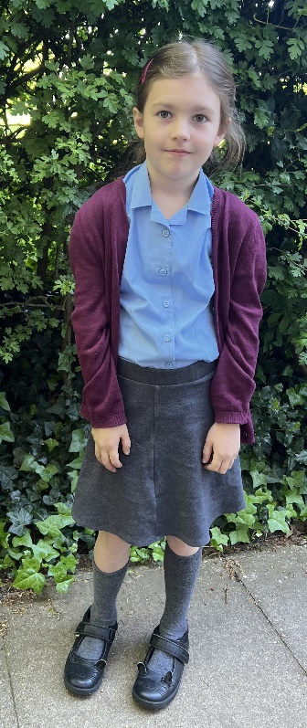
Uniform
Collared blue shirt
(no polo tops)
Grey trousers, shorts or skirts
Black shoes (no trainers unless there is a medical reason)
No bracelets/loom bands
No playsuits
No large or flowery hair accessories
No nail varnish
No number 1 hair cuts
Notes:
Collared shirt and different PE kit +blue socks

Slide 7
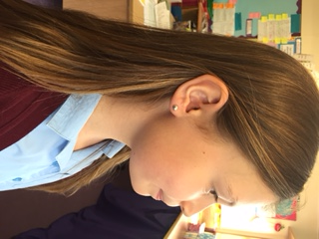

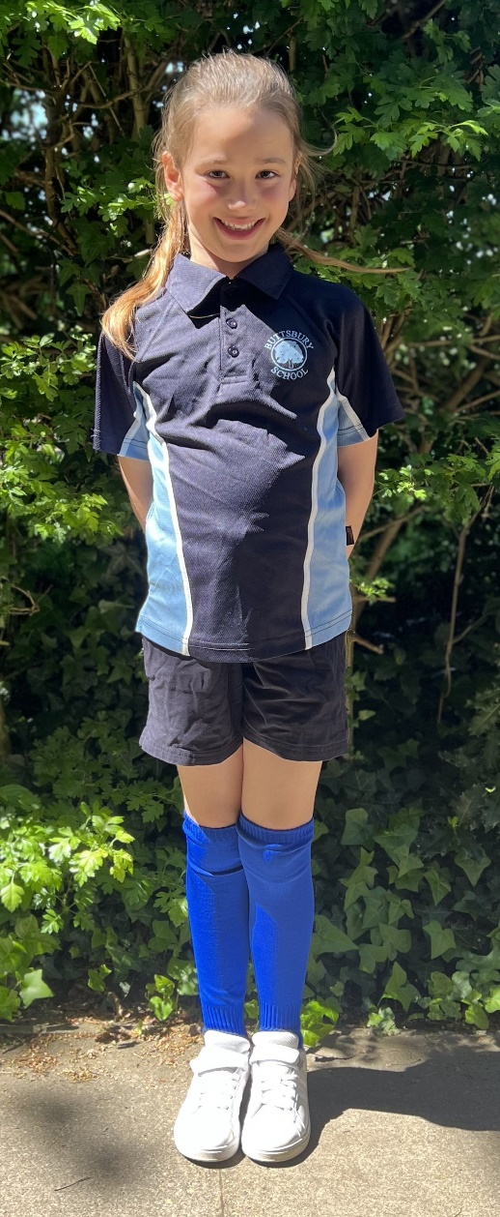
P.E Kit
School P.E top
Change of socks
No earrings for PE - please get them pierced during the summer if you intend to next year.
Hair ties needed.
The children will be given a P.E bag this year.

Slide 8
Your Child’s Belongings
All clothing and PE kit to be clearly named.
Children require plimsolls for indoor PE and trainers for outdoor Games (NO football boots)
Lunch boxes and water bottles to be named
Old shirt needed for painting & art work
Pencil cases are optional (small please) no smelly equipment please.
  Coloured pencils, pencil, ruler, rubber, glue stick and sharpener
School bags need to be small

Slide 9
Playtime & Lunchtime
Year 3 will have a separate playground the first week.
Year 6 Buddies to ‘look out’ for Year 3 children.
Fresh fruit and vegetables only at break time.
School Lunch menu can be found on school website.

Slide 10
Homework
Homework is set every Thursday
Handed in for Tuesday
30 minutes for each task
Maths - arithmetic and questions related to the topic taught that week
English/Topic Rotation – GPS + reading comprehension/topic work/writing task
Challenges 1-3 (3 = most challenging)
Also regular reading (at least 3 times a week) to be recorded in your child’s Reading Diary
Learning Spellings and Times Tables

Slide 11
Spellings
Weekly spellings are set and shared at the start of the term
Paper copy given and they will be on the school website
Test on Friday
Results will be written in your child’s Reading Diary so please make sure that it is in school

Slide 12
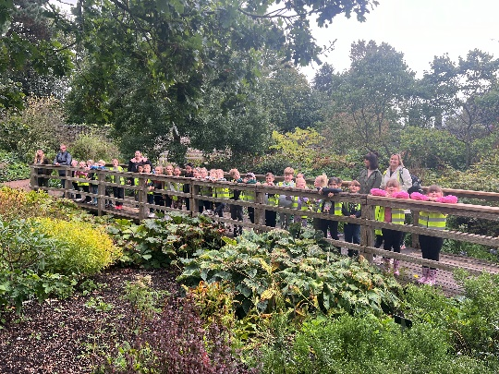
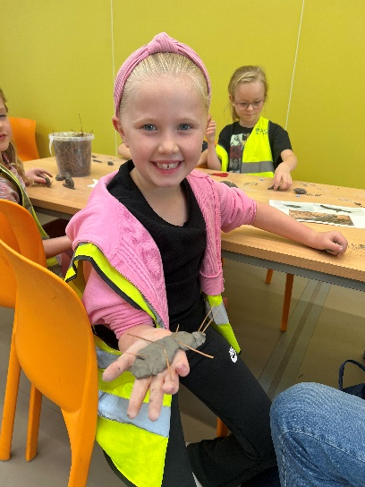
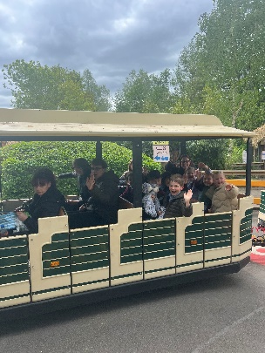
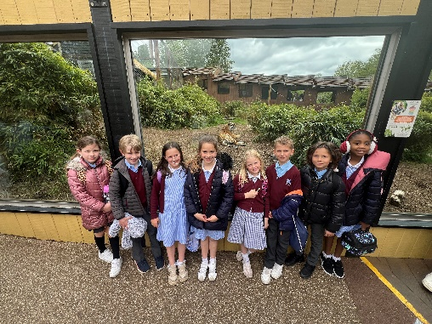
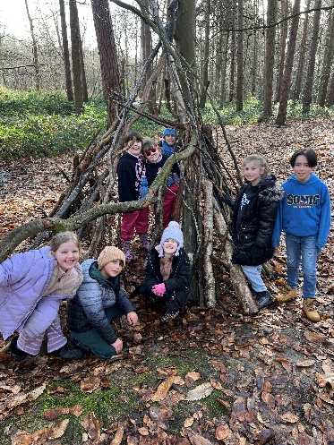
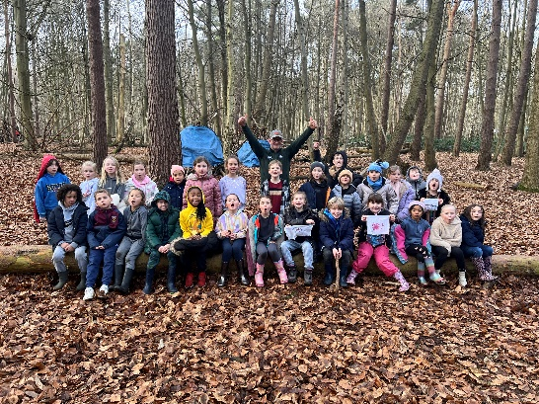
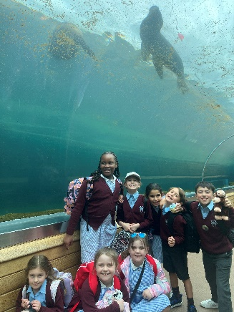
Parent Helpers & Trips
Reading
Art & D&T Mornings
Visits:
  Hyde Hall
  Pantomime
  Thorndon Country Park
  Norsey Woods
  Colchester Zoo
  Guru Nanak Marg Visit

Slide 13
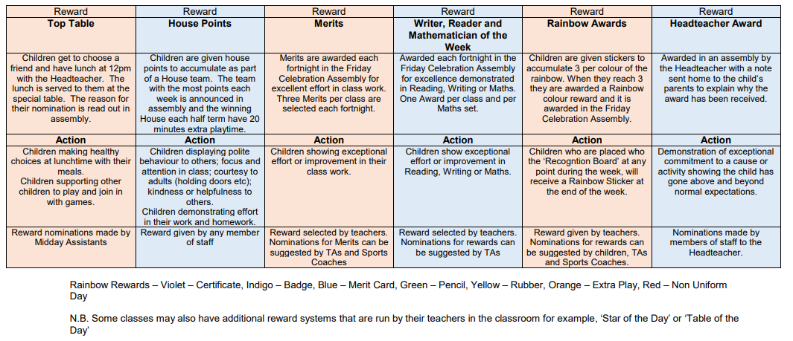
Rewards
House Points
Rainbow Awards
Merits
Headteacher’s Awards
Top table Awards
Notes:
We only give out 5 every two weeks.

Slide 14
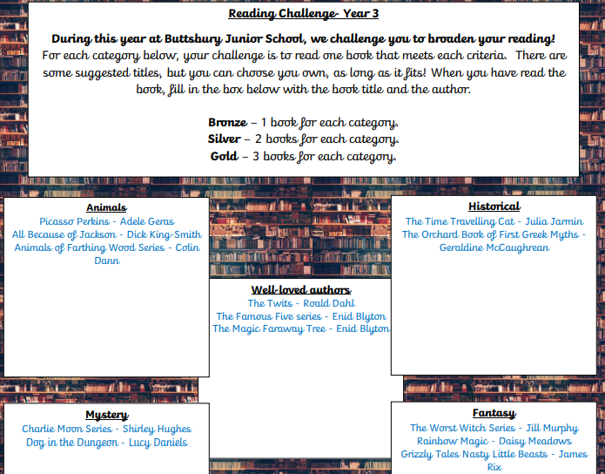
Reading Challenge

Slide 15

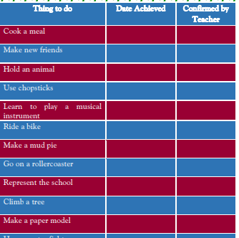
50 things…

Slide 16
Parent Communications
Year 3 Newsletter
Weekly Newsletter from Mrs Robinson
Reading Diary (Reading Books)
Parents’ Evenings - Autumn & Spring
Celebration Evening in Summer Term
Curriculum Share Evening
If you need to see your child’s Class Teacher please make an appointment through the school office
Please speak to us if you have any concerns
Notes:
Reading records checked once a week – Monday.

Slide 17
General Organisation
Dinner money - £2.95 per day from September
All money for dinners and trips is payable on Parentpay. Activate your account immediately.
Absences:
  Please report your child’s absence on Studybugs – please see the home page of our website for details.
  If the office have not heard from you by 09.10am they will ring you.
Notes:
UPDATE DATE

Slide 18
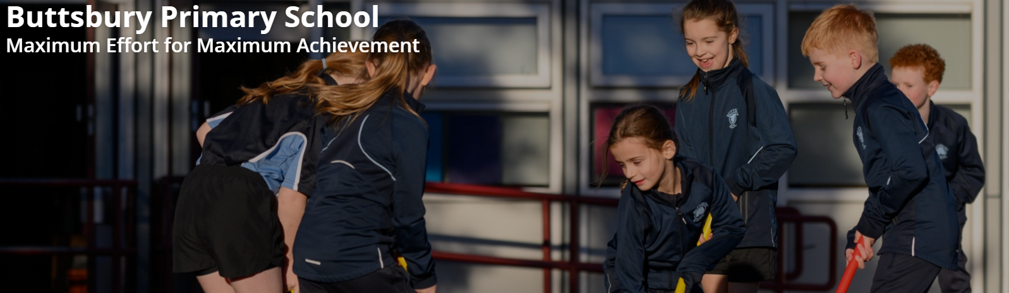
BUTTSBURY PRIMARY SCHOOL
We can’t wait to welcome your children and you to Year 3!
Thank you for coming.
Are there any questions?

