Slide 1
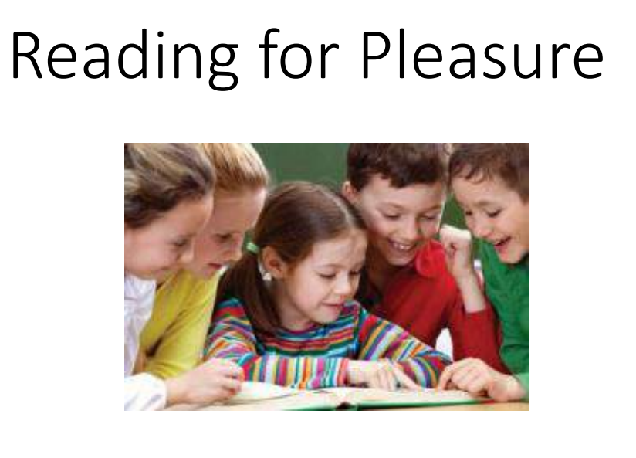
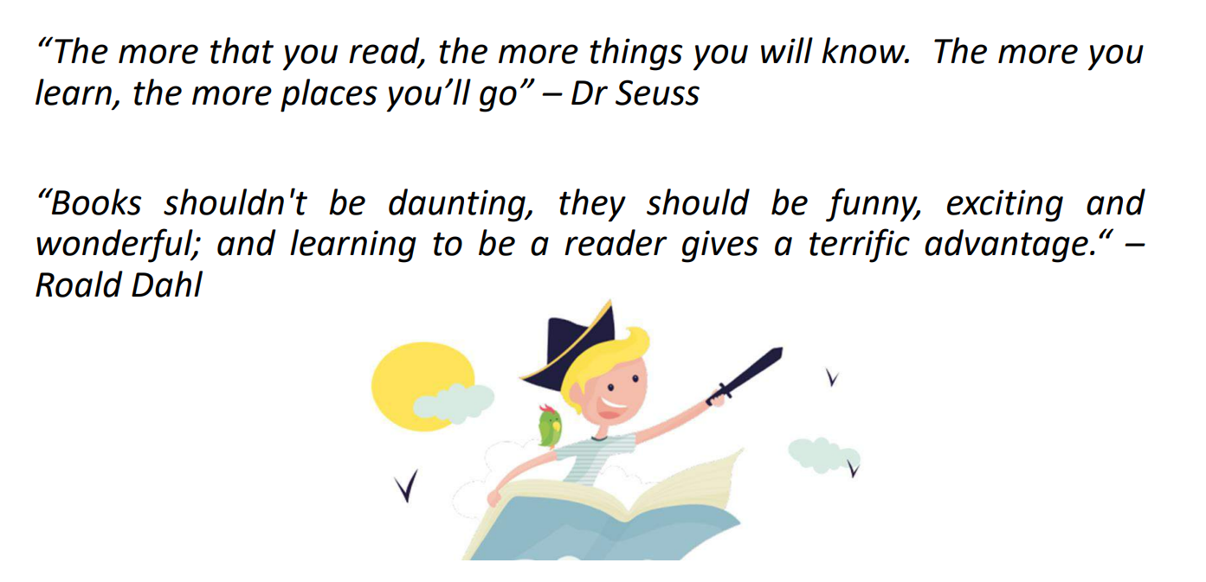
Buttsbury Junior School and Buttsbury Infant School
Parent Workshop
Wednesday 25th September 2024
LW

Slide 2
What we’ll talk about today
• The benefits reading offers your child
• The power of reading
• Reading for pleasure
• Help with ideas to encourage your child to read at home
• Questioning strategies
LW

Slide 3
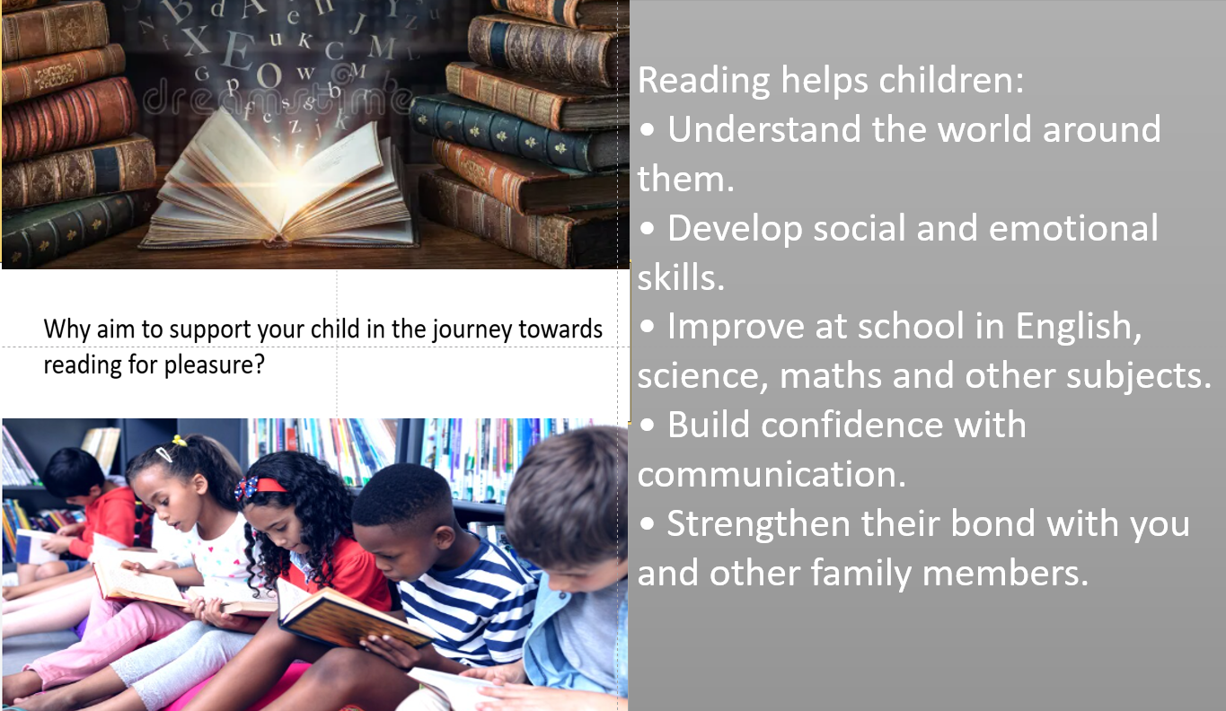
FC

Slide 4
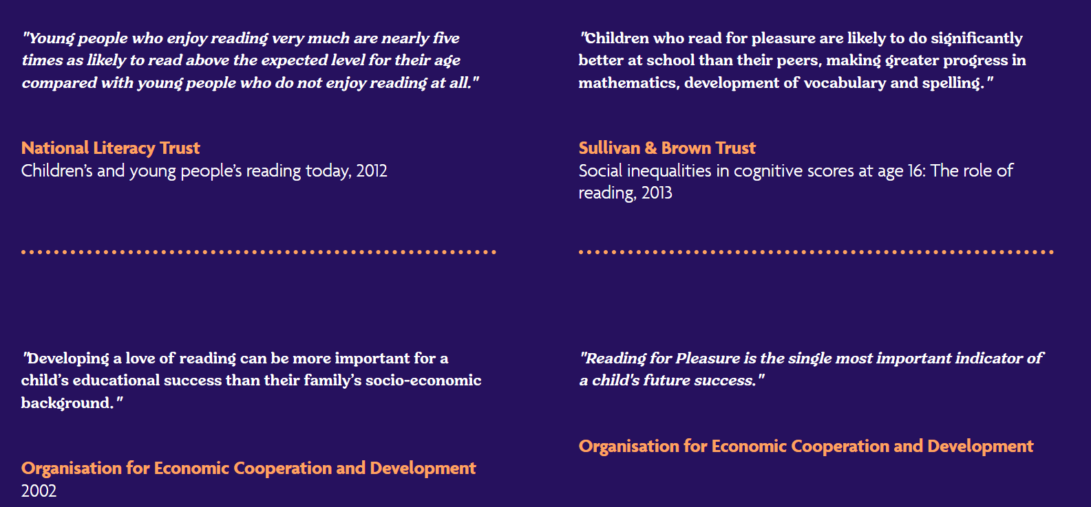
THE EVIDENCE
FC

Slide 5
MORE EVIDENCE
“Researchers in the United States who looked at the impact of parents reading with their children quoted the following figures in a news release about their findings: Here’s how many words kids would have heard by the time they were 5 years old: Never read to, 4,662 words; 1–2 times per week, 63,570 words; 3–5times per week, 169,520 words; daily, 296,660 words; and five books a day,1,483,300 words.”
The Reading Framework, Department for Education (July 2021)
FC

Slide 6


• Just 10-15 minutes of reading with your child each day is one of the best ways you can support their education and life chances.
• Reading aloud is a great opportunity to share and bond with your
child.
FC

Slide 7

Topic loan boxes
Class novel
World Book Day celebrations
Reading awards
Author of the term
Engaging library welcoming pupils at lunchtimes
Book Club (Year 6 leaders and Year 3 attendees)
Daily readers
Librarians (staff and children)
Guided reader group
Comprehension lessons 4X per week
Quality texts to choose from
Parent readers
FC

Slide 8

Special book boxes
Class novel
World Book Day celebrations
Reading rewards
Author of the term
Daily reading for pleasure
Library bus!
Daily readers
Book corners
Reading lessons
Books at playtimes and lunchtimes
Quality texts to choose from
LW

Slide 9

Reading at home-
Have a variety of books at home- let your child choose from these.
Be a reading role model- let your child see you read for pleasure.
Read together and share books everyday- talk about your likes and dislikes- it’s okay not to enjoy a book!
Boys in particular, need to see that reading is something that men do.
LW

Slide 10


How does seeing role models read influence children and young people's reading?
More than half (52.9%) of children and young people who had a role model agreed that seeing their role model read would make them think it's okay to read.
93.4% of children and young people aged 7 to 18 had at least one role model.
The most popular role models were mums (67.4%) and dads (60.2%).
LW

Slide 11
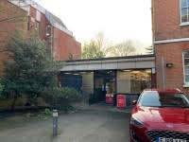
Reading with your children
• It’s not all about stories. Let them see different types of books – not just fiction, but non-fiction, poetry, joke books, magazines- anything that they enjoy!
• Try to use different, funny voices for characters- think about what the might sound and look like.
• The best question to ask is, ‘What are you going to try next?’
Visit the library to choose books.
LW

Slide 12

Where to read?
You can read anywhere!!
LW

Slide 13


Closed Questions
• Do you like this book?
• Do you like this character?
• Who are the main characters
• Where is the story set?
• Is it summer or winter?
Open questions
• What do you like about this book?
• What can you tell me about the main character?
• How do you know it is summer?
• How do you know the book is set in Victorian times?
• What would you do in that situation?
FC

Slide 14
How to help if your child chooses not to read-
• First of all, don’t panic!
• Let them choose books that appeal to them
• Find books to share that match your child’s interest
• Continue to role modelling reading.
• Take the strain, read aloud to your child
• You can’t make someone read. Just like you can’t make them fall in love, or dream…’
LW

Slide 15



The Rights of the Reader
1. The right not to read.
2. The right to skip.
3. The right not to finish a book.
4. The right to read it again.
5. The right to read anything.
6. The right to mistake a book for real life.
7. The right to read anywhere.
8. The right to dip in.
9. The right to read out loud.
10. The right to be quiet.
Daniel Pennac – The Rights of the Reader
FC

Slide 16
EYFS in 3P classroom
Year 1/2 in 3M classroom
Please join us in the break out room of your choice. Specialist teachers will be available to answer any questions!
Year 3/4 in 3LW classroom
Year 5/6 in 6B classroom

