Slide 1

Maths Parent Workshop

Slide 2
Aims:
Introduction WRM
Explore the CPA approach
HW expectations
Multiplication Facts
Notes:
RD

Slide 3
White Rose Approach
Small steps: Each topic is broken into smaller curriculum areas to allow breadth of a subject to be learnt and mastered.
Number heavy: Children have plenty of opportunity to understand the value of numbers, investigate the relationship between numbers, number operations and application – just as they would in the ‘real world’.
Varied fluency
Expose to range of reasoning, application and problem solving
CPA
Notes:
RD
Small steps: Science has shown that children learn and remember more by learning maths in small, related chunks.

Slide 4
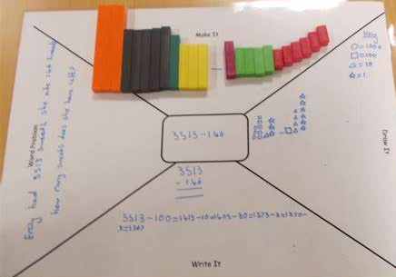
What is CPA?
Concrete
Abstract
Pictorial
Reasoning
Children can use all stages of the CPA to prove and explain their reasoning.
Notes:
AG
Positive approach as it scaffolds learning – fluency, reasoning, problem solving and application
Concrete – using physical manipulatives to represent and recreate numbers, calcualtions, problems
Pictorial – using visual representations to represent concepts, numbers, calculations, problems
Abstract – uses symbols we associate with calcaultions
Working towards abstract – different children reach different stages at different times
Enables new concepts to be developed and understood – concept rather than the procedure – more able mathematicians understand what is happening when and why

Slide 5
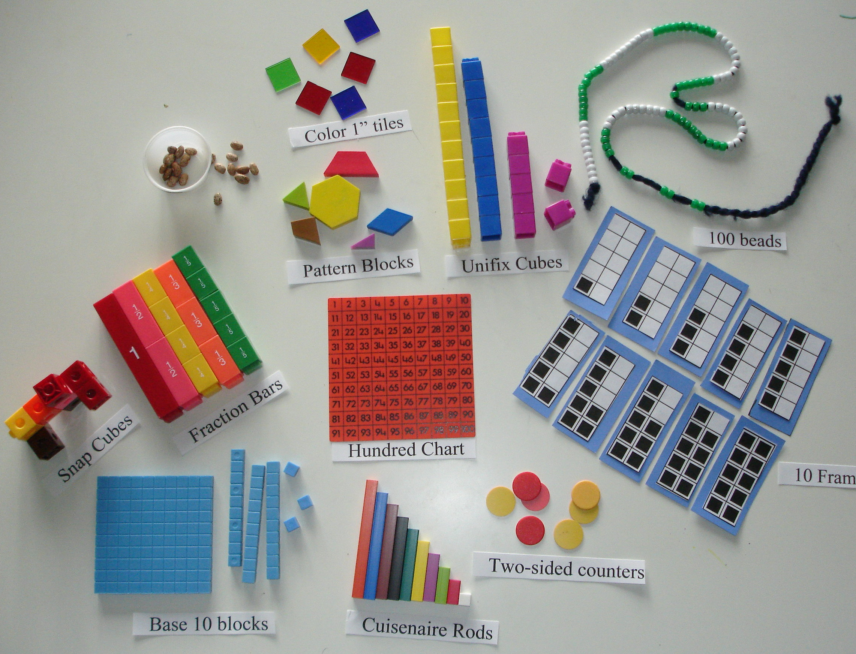
Concrete
Use concrete objects and manipulatives to help children understand what they are doing.
40,590
Notes:
AG
Practical
Non-threatening as no commitment to paper
Early acquisition puts maths into context – can see what is happening
More accomplished – develop and enhance reasoning. In literacy, if they can’t say it, they can’t write it – same applies for maths, if we don’t have the vocabulary, order and precision fully understood they can’t explain and record this.
Challenges thinking – Y6 Set 1 ‘If I add a number to a place value column, then only one place value will change’ – 75% yes, only one PV will change
X and / 10, 100, 1000

Slide 6
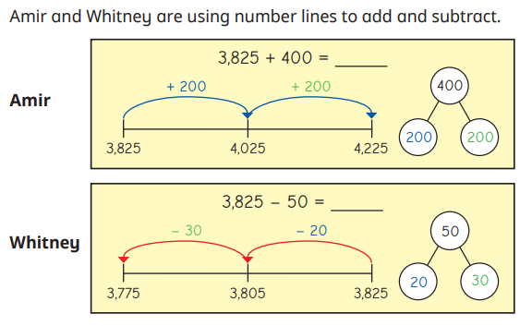
Pictorial
Number lines and Part whole models (Cherry Diagram)
Bar Models
400
200 | 200
50
20 | 30
Notes:
RD
Scaffold progression
Independent tool children can recreate to tackle questions independently - visualise when resource not available
Break problem down into a story – time.
For some children, approach may be simpler than using a traditional approach of RUCSAC – underline and choose – great, it doesn’t help me to choose just because I’ve underlined numbers
Also helps to recognise that the whole can be anything – not just a whole number e.g. 10 but it could be a decimal, Money, temperature, fraction, percentage,

Slide 7
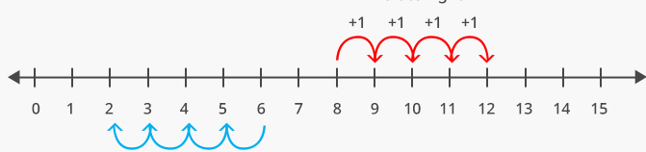
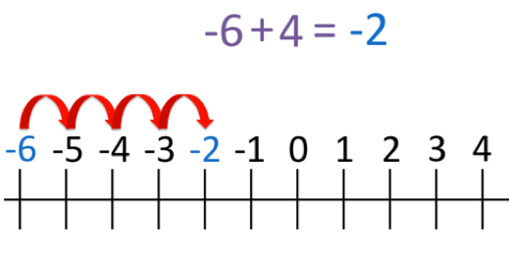
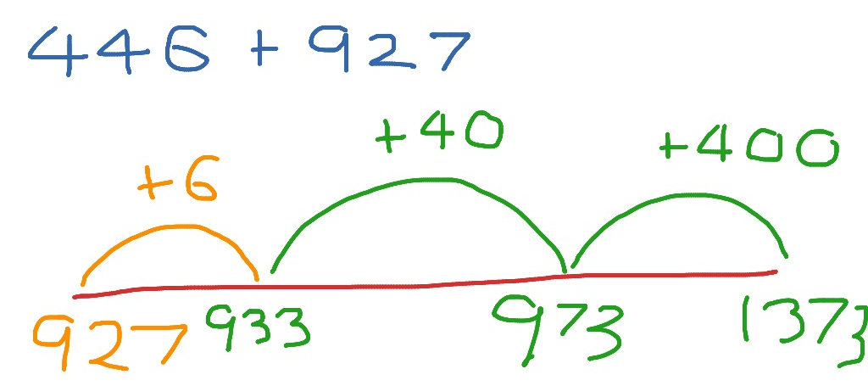
Number line
8 + 4 =
20 + 110 =
+ 80 +30
6 - 4 =
20
100
130

Slide 8
Pictorial
Part-whole model
120,065
120,065
100,000
20,005
120,000
65
60
Notes:
RD
Partition
– first thought is into place values – however sometimes requires a different angle – comes with greater understanding of number and values working with – depth of understanding

Slide 9
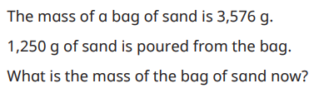
Pictorial
Part-whole models (Cherry Diagram)
Part-whole model
3,576g
1,250g
?
Notes:
RD
Partition
– first thought is into place values – however sometimes requires a different angle – comes with greater understanding of number and values working with – depth of understanding

Slide 10
Pictorial
In Stockholm the temperature is -3 º but Paris is 12º warmer.
What is the temperature in Paris?
Will the same pictorial always support a child with a reasoning problem?
12
+3
+9
10
3
2
9
-3
0
9
Notes:
RD

Slide 11
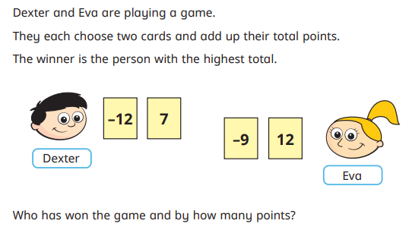
Could you use a number line to answer this question?

Slide 12
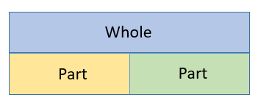
Bar Modelling
Part A + Part B = Whole
Part B + Part A = Whole
Whole – Part A = Part B
Whole – Part B = Part A
Whole
Part A
Part B
Notes:
AG
Visual representation and can represent nearly any problem
Whole, Parts
Simple and gets more complex but if children don’t understand simple context and it builds
Introduce concept of inverse, + being commutive and – isn’t
More complex, finding the whole – represent it visually

Slide 13

Bar Modelling
Notes:
AG

Slide 14
Bar Modelling
Peter eats 24 sweets which is 2/5 of the packet. How many were in the packet at the start?
Notes:
AG
Parents try
Adults – learned/educated people have stratergies and unserdatnding of concepts so don’t always feel these are effective but research informed -

Slide 15
Abstract
This is when Children use digits and symbols to demonstrate their calculations and answers.
Depending on the lesson, content and Year group, this is introduced at different points and is used alongside the Concrete and Pictorial part of the lesson.
Notes:
RD

Slide 16
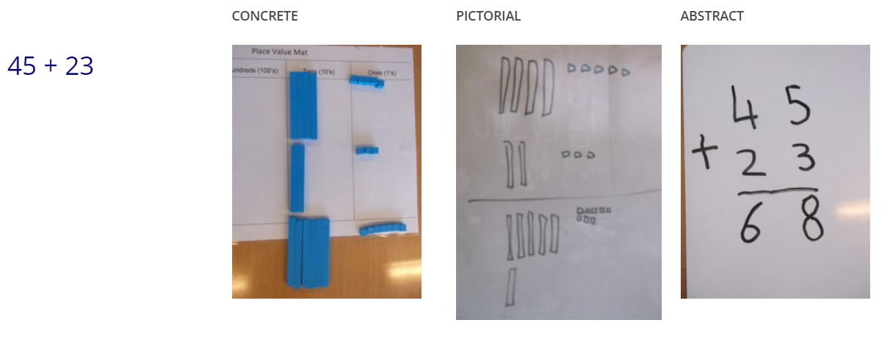
Notes:
RD

Slide 17
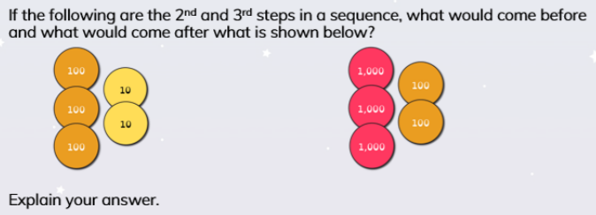
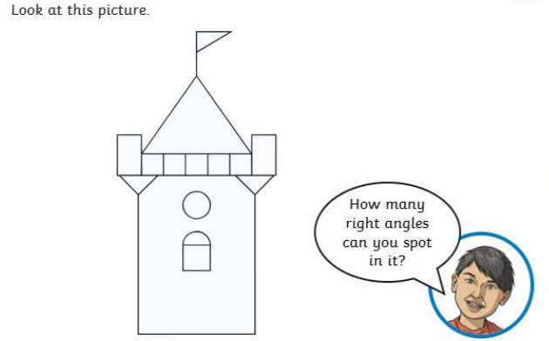
(Varied) Fluency
Notes:
RD

Slide 18
Reasoning
How does this statement help you to solve these?
5 + 7 = 12
120
?
220
?
50
?
15
7
?
70
450
70
Notes:
AG
Reasoning – is the link between fluency and problem solving
More able mathematicians are able to do this effectively – use vocabulary, make links between concepts and are able to describe concepts.
This can be required in different ways e.g.

Slide 19
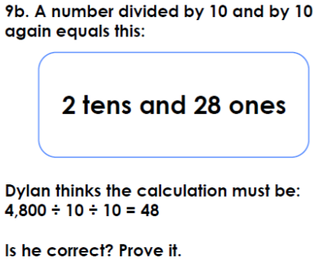
Reasoning
Notes:
AG
True or False? Prove It? Common reasoning.
Shows a deeper understanding. Ability to manipulate numbers
Different ways – convert all to ones, or to whole number, recreate using concrete.
Perseverance, pattern spotting

Slide 20
Homework
-Times table focus
-Arithmetic questions – children must show their workings
-Task related to learning that week
C1/ or C2/3
Notes:
RD

Slide 21
Multiplication Facts
Notes:
FC

Slide 22
Multiplication Facts in KS2

Slide 23
National Curriculum requirements
End of Year 2
Children recall and use multiplication and division facts for the 2, 5 and 10 multiplication tables.
End of Year 3
Children recall and use multiplication and division facts for the 3, 4 and 8 multiplication tables.
End of Year 4
Children recall multiplication and division facts for multiplication tables up to 12 × 12.

Slide 24
Why are times tables so important?
Fractions
percentages
Factor pairs
Decimals
Problem solving
Square/cube numbers
Problem solving
Reasoning
Scaling
Comparing data
Ratio and proportion
Secondary school progress
Life!
Just a few reasons!

Slide 25
Multiplication Tables Check (MTC)
When?
2022: “schools must administer the MTC to all eligible year 4 pupils between Monday 6 June and Friday 24 June.”
2023: dates not released yet.

Slide 26
What is it?
https://www.gov.uk/government/publications/multiplication-tables-check-information-for-parents/multiplication-tables-check-information-for-parents-text-version--2
25 questions in the format 6 X 5 =
no gaps eg 6 X ? = 30
6 seconds to answer each question
there is an emphasis on the 6, 7, 8, 9 and 12 multiplication tables because these have been determined to be the most difficult multiplication tables
we will share your child’s results with you on their Summer report

Slide 27
Times Tables Rockstars (TTRS)
parent guide handout available
passwords stay the same
in Year 4, they have been put in the front of the children’s maths homework books
soundcheck is very similar format to the MTC

Slide 28
Other fun ways to learn times tables!
Songs
Use dice
Use the clock
Flashcards
Board games
Little and often!
Helpful booklet you can download from the internet.
https://assets.oxfordowl.co.uk/2014/05/13/10/30/08/349/PX_MathsContent_BK_TimesTablesInSchool_01_CH.pdf

Slide 29
Please remember it is part of homework!
THANK YOU

