Slide 1

SEND – Level of Support

Slide 2
Level of Support | What this means? | On SEND Register? | Paperwork | Meetings
Academic Monitoring | During Pupil Progress meetings each half term, children who have not made the expected progress will be identified and added to a Academic monitoring list. | No | No | No
SEND Monitoring | Children placed on the SEND monitoring list will be those we need to keep a close eye on concerning their progress, emotions, or behaviour. | No | No | No
Record of Concern | Students on a Record of Concern will have a personalised One Page Profile outlining necessary adaptations to support their learning. This level of support is supported through the ‘ordinarily available’ framework. | No | One Page Profile | The One page profile will be shared at Parents evenings. There will be a third Summer meeting to update ready for transition.
Additional Support: Teacher Led SENCo Led | Children we identify as having a SEN need that can be supported at targeted level (through interventions, some outside agency support etc) If an application has been made for an EHCP or it is looking as though one will need to be made. | Yes Yes | One Page Profile for adaptations and a One Plan where teachers will set termly targets. | These targets will be reviewed three times a year to evaluate progress and ensure appropriate support levels. This will happen in a double slot for parents evening and a third meeting in the Summer. These meetings are held before or after school with the SENCo and the class teacher.
EHCP | This is the highest level of support, where outside agencies are involved and support given from the local authority. | Yes | One Page Profile One Plan Annual Review | Two One Plan meetings per year, and an annual review to monitor progress against EHCP outcomes. This will be led by the SENCo, Class teacher.

Slide 3
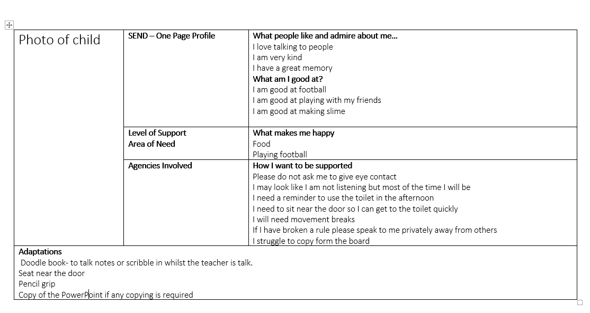
One Page Profile

Slide 4


